Slide 1
SQL PLAYER GAMING ANALYSIS
--Decoding Player Behaviour--

Slide 2
Answering questions with SQL to unravel gaming behaviours.

Slide 3
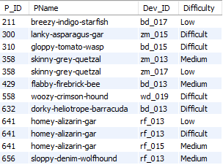
1. Extract `P_ID`, `Dev_ID`, `PName`, and `Difficulty_level` of all players at Level 0.

Slide 4

2. Find the total number of stages crossed at each difficulty level for Level 2 with players.

Slide 5

3. Find `Level1_code`wise average `Kill_Count` where `lives_earned` is 2, and at least 3 stages are crossed.
using `zm_series` devices. Arrange the result in decreasing order of the total number of stages crossed.

Slide 6
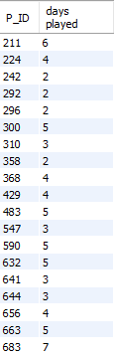
4. Extract `P_ID` and the total number of unique dates for those players who have played games on multiple days.

Slide 7
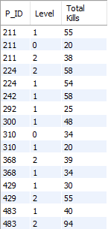
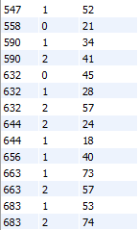
5. Find `P_ID` and level wise sum of `kill_counts` where `kill_count` is greater than the average kill count for Medium difficulty.

Slide 8
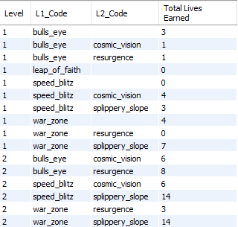
6. Find `Level` and its corresponding `Level_code`wise sum of lives earned, excluding
Level 0. Arrange in ascending order of level.

Slide 9
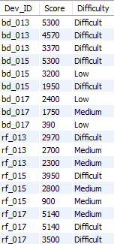
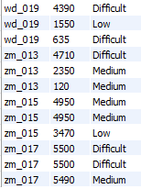
7. Find the top 3 scores based on each `Dev_ID` and rank them in increasing order using `Row_Number`. Display the difficulty as well.

Slide 10
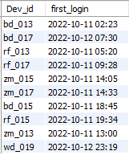
8. Find the `first_login` datetime for each device ID.

Slide 11
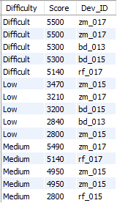
9. Find the top 5 scores based on each difficulty level and rank them in increasing order using `Rank`. Display `Dev_ID` as well.

Slide 12
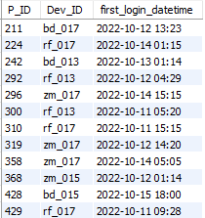
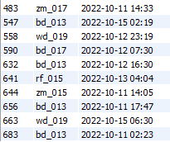
10. Find the device ID that is first logged in (based on `start_datetime`) for each player (`P_ID`). Output should contain player ID, device ID, and first login datetime.

Slide 13
THANK YOU
-- JOEL CHARLES --

